Slide 1
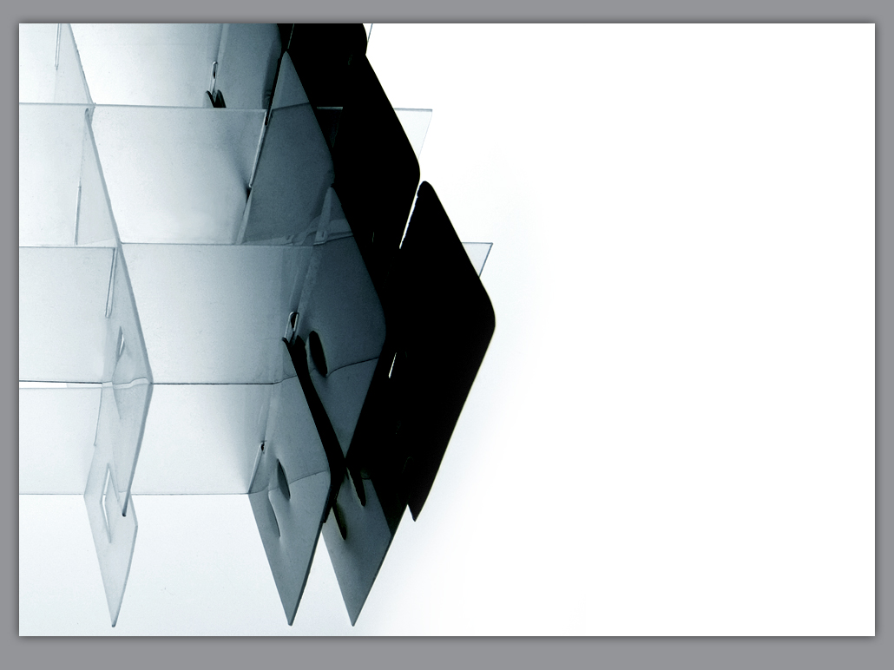


Rapid Deployment Flood Wall Technology
US Army Corps of Engineers Districts
Nation Wide
Notes:
1

Slide 2
Mission Statement
Increasing Efficiency in Emergency Protective Measures
Increases Public Safety
Reduces Recovery Cost
Limits Risk and Liability

Slide 3

Discovery Channel
Discovery Video

Slide 4

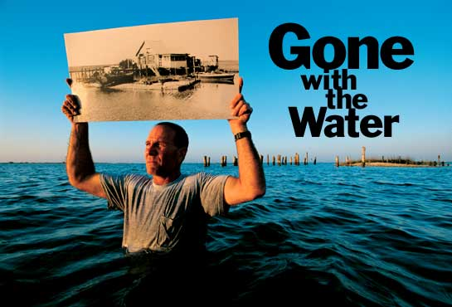
Structural Strength
Speed
Seepage Rate
Re-Use
Notes:
The purpose of this picture is to illustratepreveious USACE testing and the significance of 4 ft levels

Slide 5
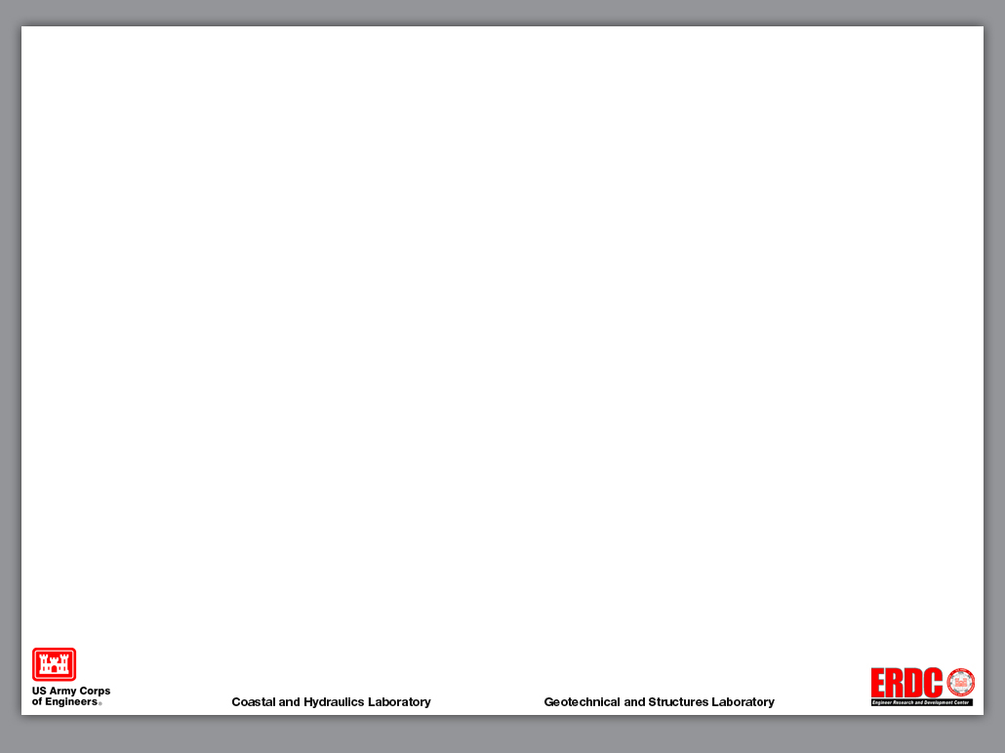
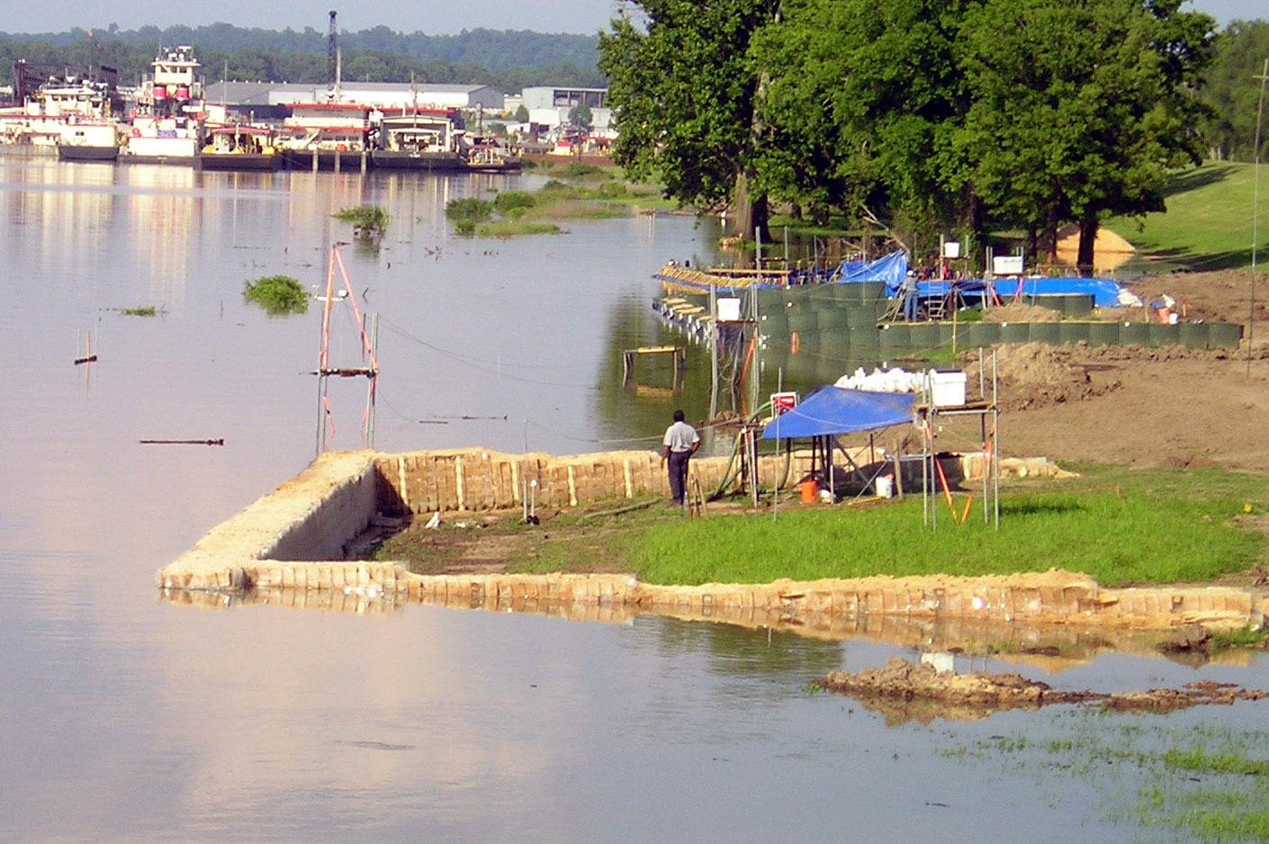
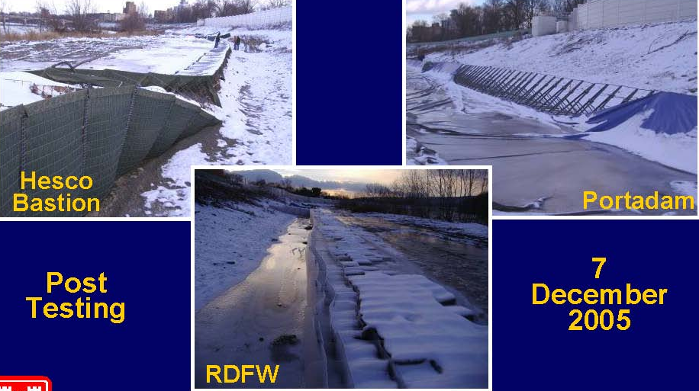
2005 USACE Testing Shows RDFW To Withstand 3 Seasons of Overtopping.
Alternative Methods Show Structure Failure

Slide 6
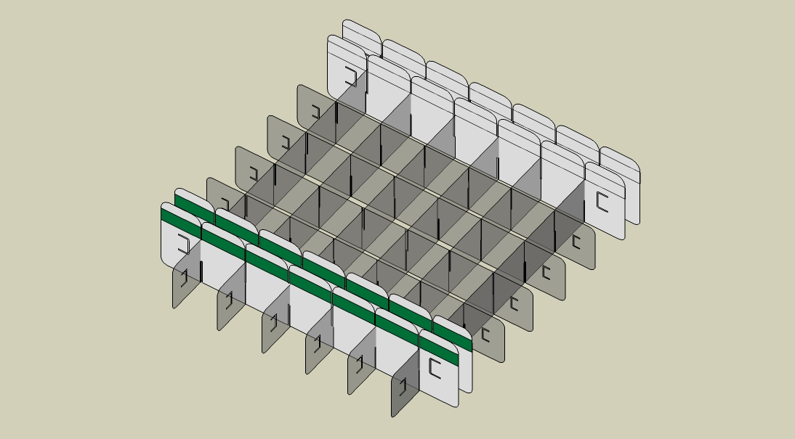
RDFW Internal Trusses Provide Reinforcement Unparalleled Structural Strength.
Reinforcement Truss
Containment Cells
Protective Cells
Connectors
Connectors
Reinforcement Truss
Notes:
The patented RDFW uses native sand and reinforcement to hold sand vertically and develop structural strength

Slide 7
RDFW Technology
Architecture
  Structure
    Internal cells transform into reinforcement
    Confined sand builds compression inside the structure
    Vertical load bearing capacity = 31,000 psi per 8”cell
    One universal base unit
    No additional parts, props or hardware
  Materials
    High strength plastic
    Native Sand
    Re-useable / Recyclable
  US Patent No. US 6,817,806, B1

Slide 8
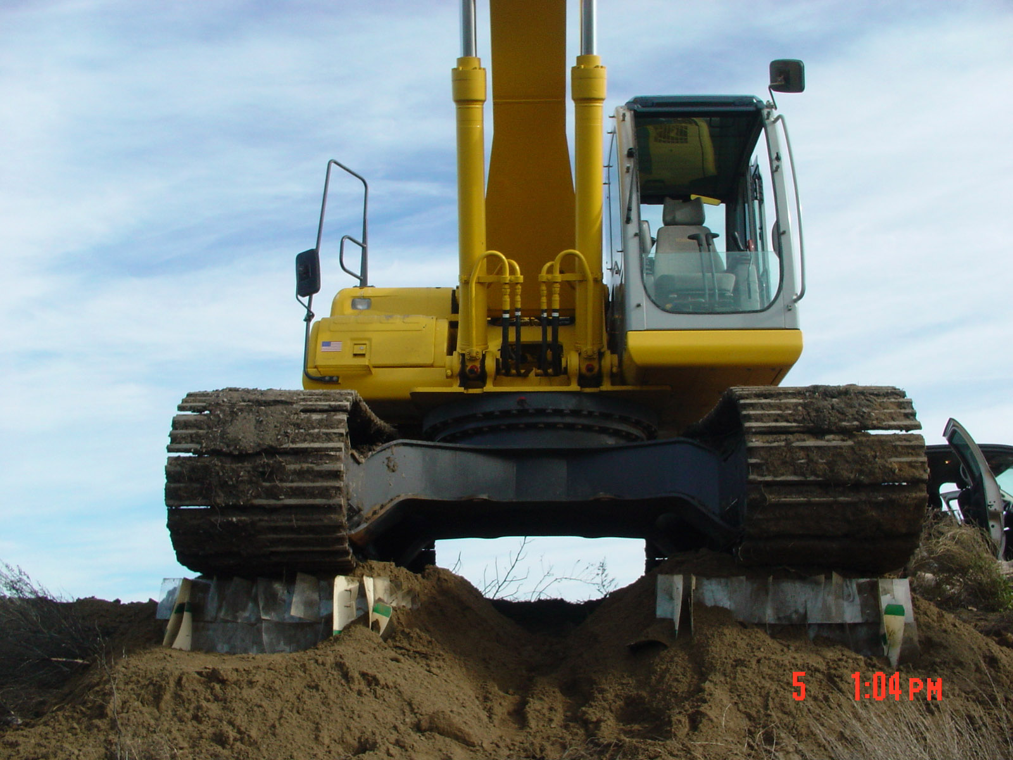
Structural Strength

Slide 9
Winzler and Kelly Engineering Consultants
10. 4.2 SINGLE-MODULE WIDE, 6 FOOT HIGH RDFW
Analysis results with and without the internal Geocell grid structure are presented on Figures 4.1-1 and 4.1-2.
With the internal Geocell grid structure, the pushover analysis shows a maximum lateral load of about 990 lbs (1700 plf) at a top lateral displacement of 100 inches. Without the internal grid, no intermediate yield zones occur and the analysis shows a maximum lateral load of about 111 lbs (190 plf) at a top lateral displacement of 100 inches. This analysis indicates that the presence of the internal Geocell grid increases the wall ultimate capacity by about a factor of 8.9 and the wall initial stiffness by about a factor of 10.

Slide 10
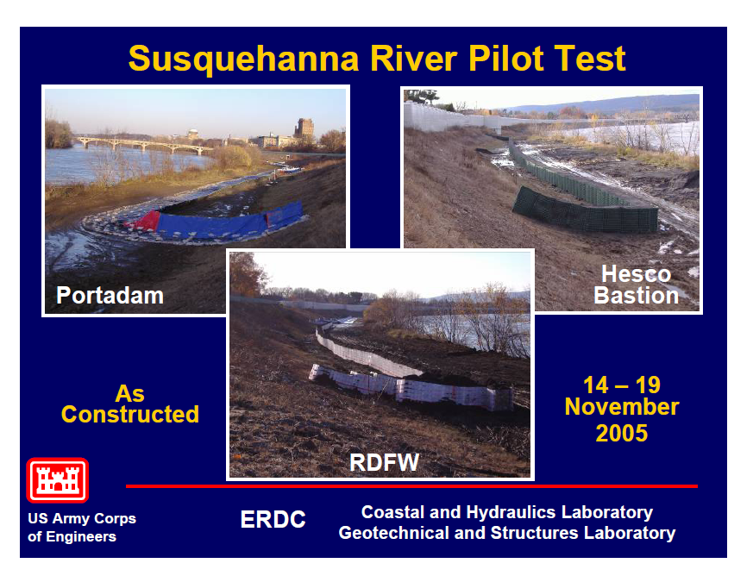
Significance of Internal Reinforcement

Slide 11
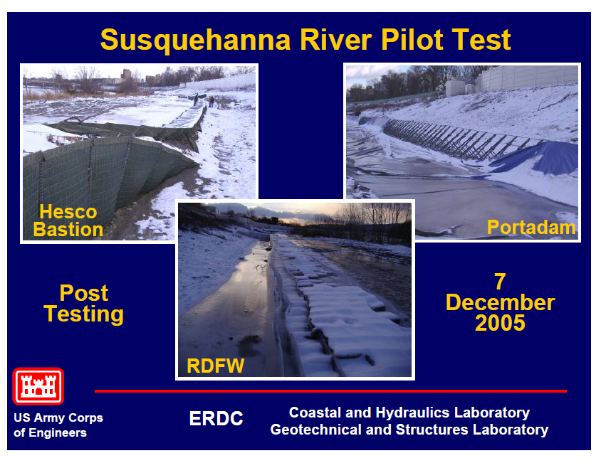
RDFW Withstood 3 Overtopping Incidents at Susquehanna Site

Slide 12
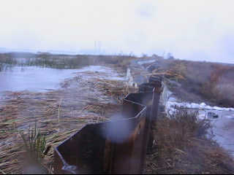
Van Sickle Island, San Joaquin Delta California, 2008

Slide 13
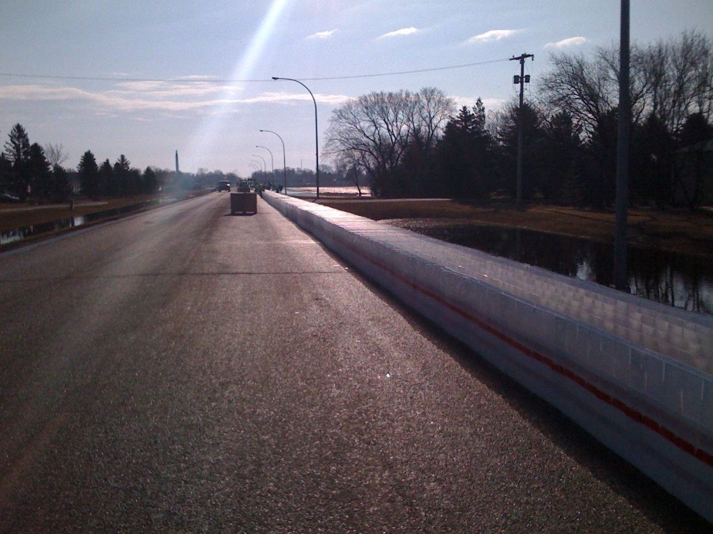
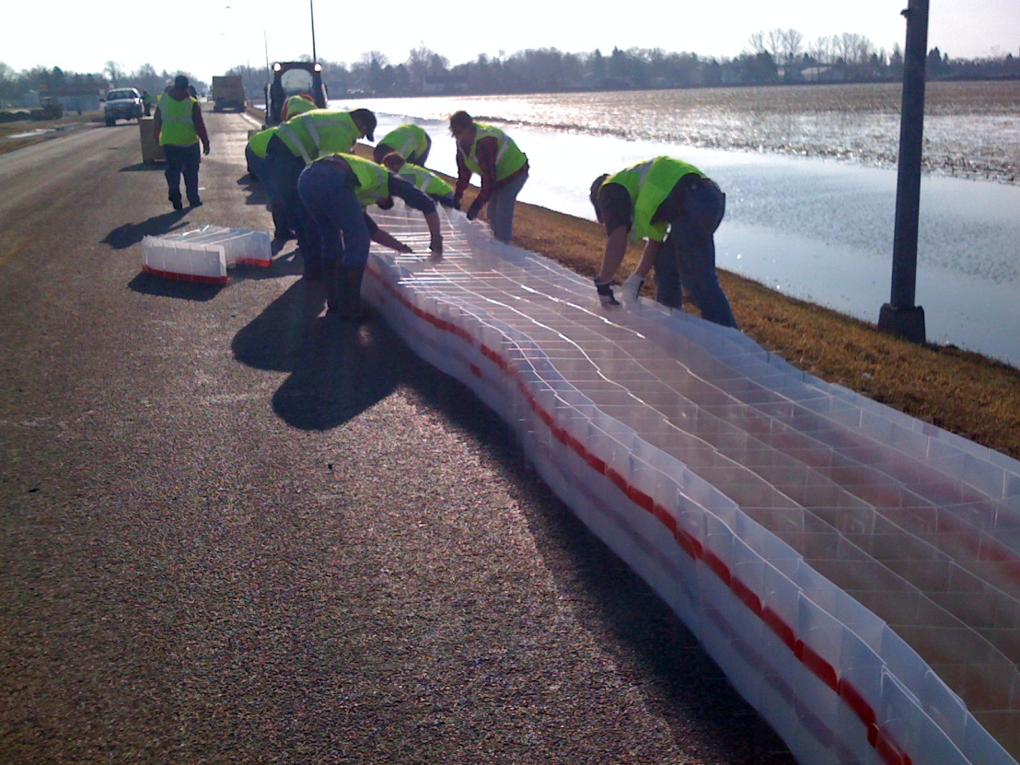
Deployment Speed
2005 USACE Laboratory Test Shows RDFW Installed at a Ratio of 38:1 vs. Traditional Sandbags Methods
Actual Emergency Installation in Lamoure, N.D. 04/2009
11 volunteers trained on site - installed 2,200 lineal feet averaging 3 feet high RDFW in 7.5 hours

Slide 14
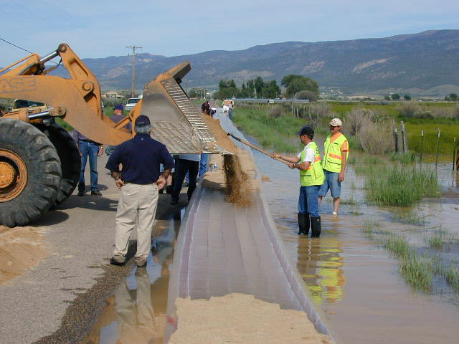
In Chrystal Springs, Utah 12 Volunteers Trained on Site – Placed 535 lineal feet in 35 minutes

Slide 15
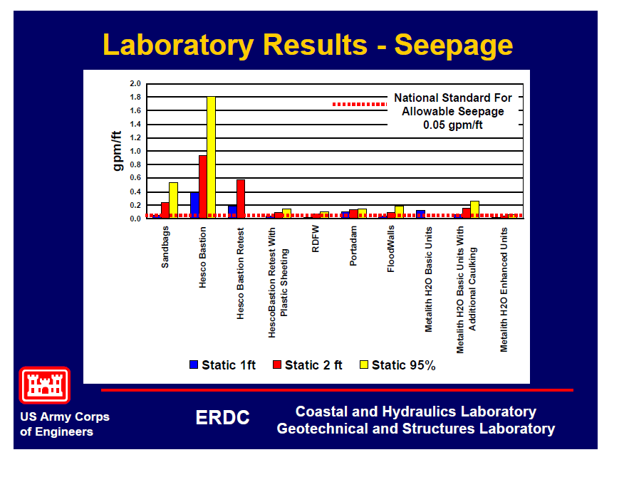
ERDC Lab Testing Seepage Rates

Slide 16
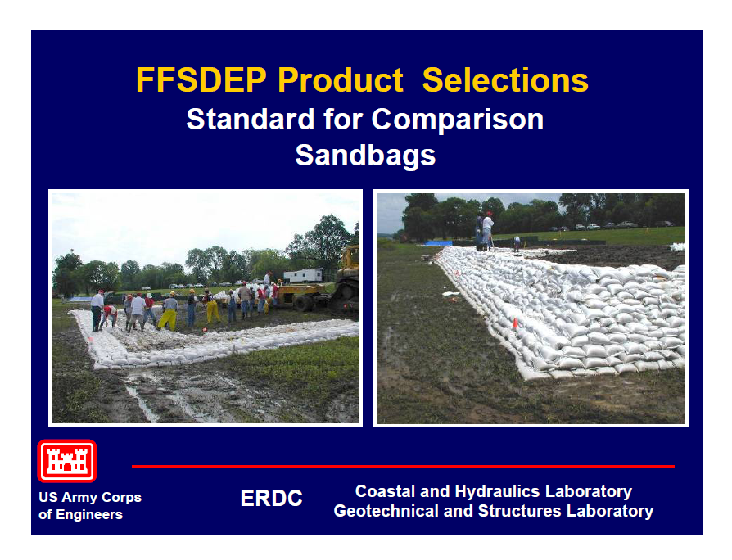
ERDC Field Testing

Slide 17
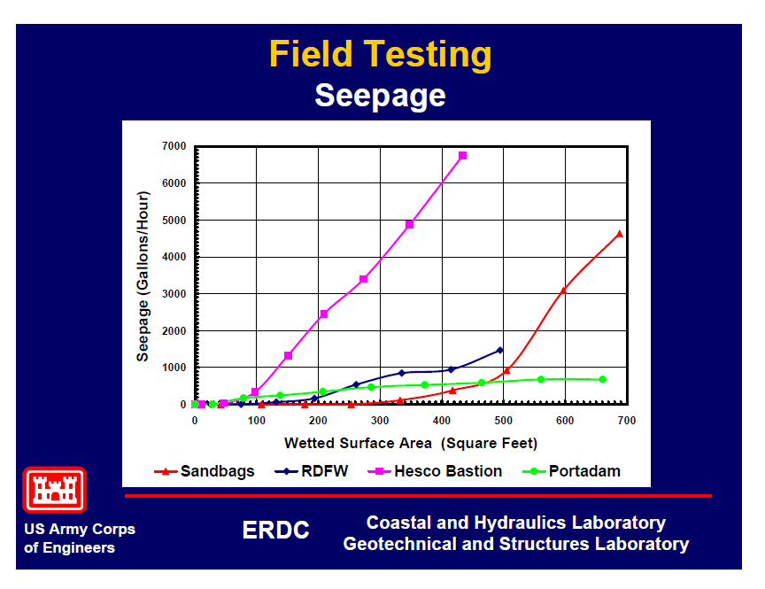
ERDC Field Testing

Slide 18
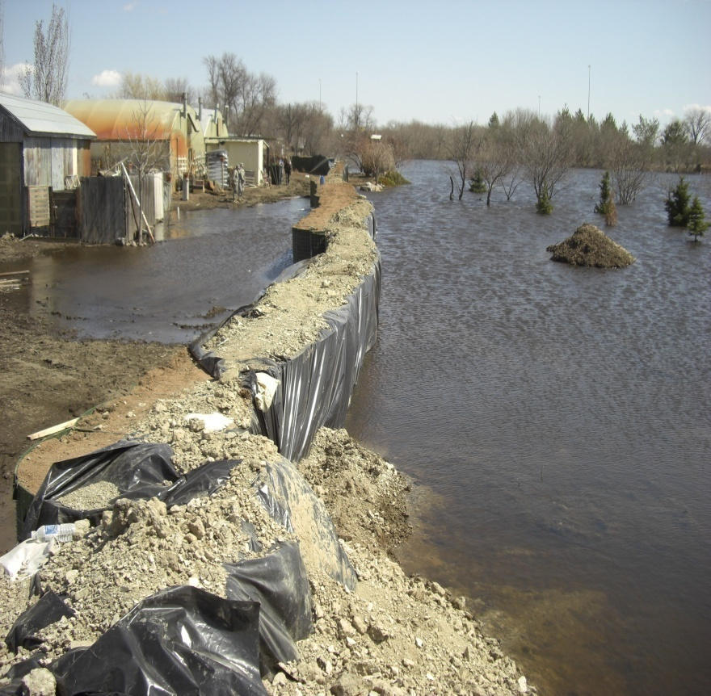
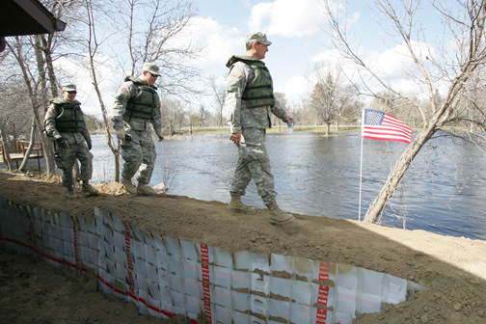
Seepage Reduction
Jamestown N.D. 2009
Alternative Methods
Geocell Systems RDFW

Slide 19
Applications
Levee Overtopping

Slide 20
2005 USACE Testing Shows RDFW To Withstand 3 Seasons of Overtopping.
Alternative Methods Show Structure Failure

Slide 21
8 Inch Layer
Adaptable to various threats and conditions
  Wind
  Conforms to Terrain Horizontally and Vertically
  Scalable to conserve on import
  Can be immediately raised or widened
  Various configurations apply to:
    Road Building
    Boil Control
    Levee Overtopping

Slide 22
Working in Confined Areas
RDFW is strong enough to be immediately filled and traversed using a skid loader.
RDFW can also be filled with an:
  Excavator
  Clam Shell Crane
  Wheel or Track Loader
  Wheelbarrow

Slide 23
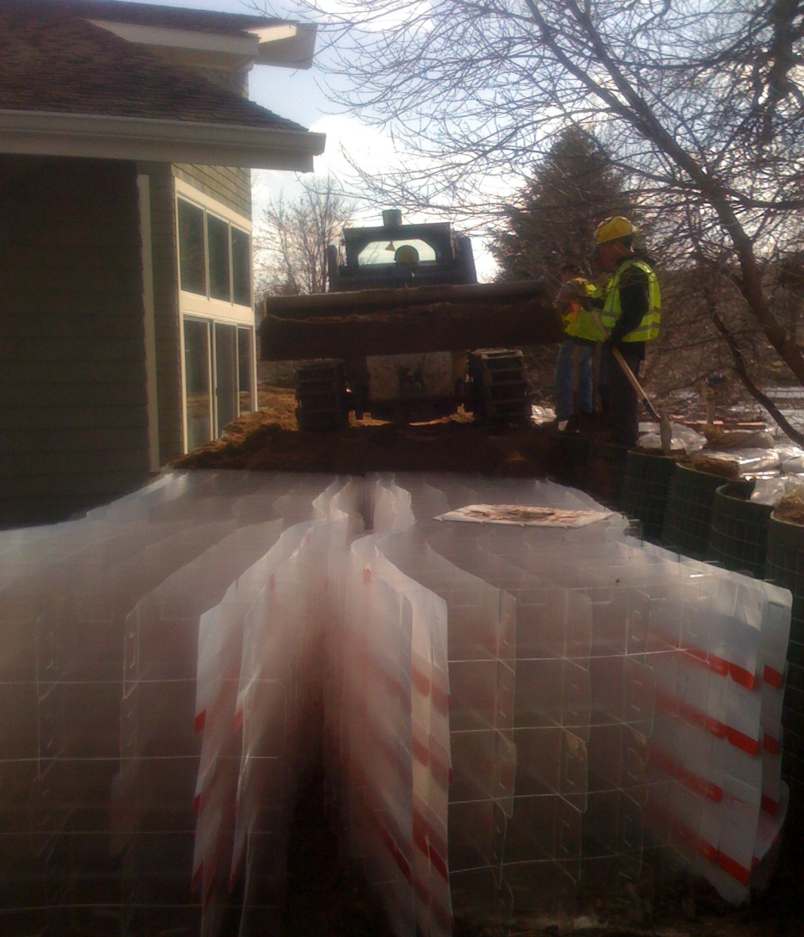
Skid Loader Fills and Travels Over Top of RDFW Structure

Slide 24
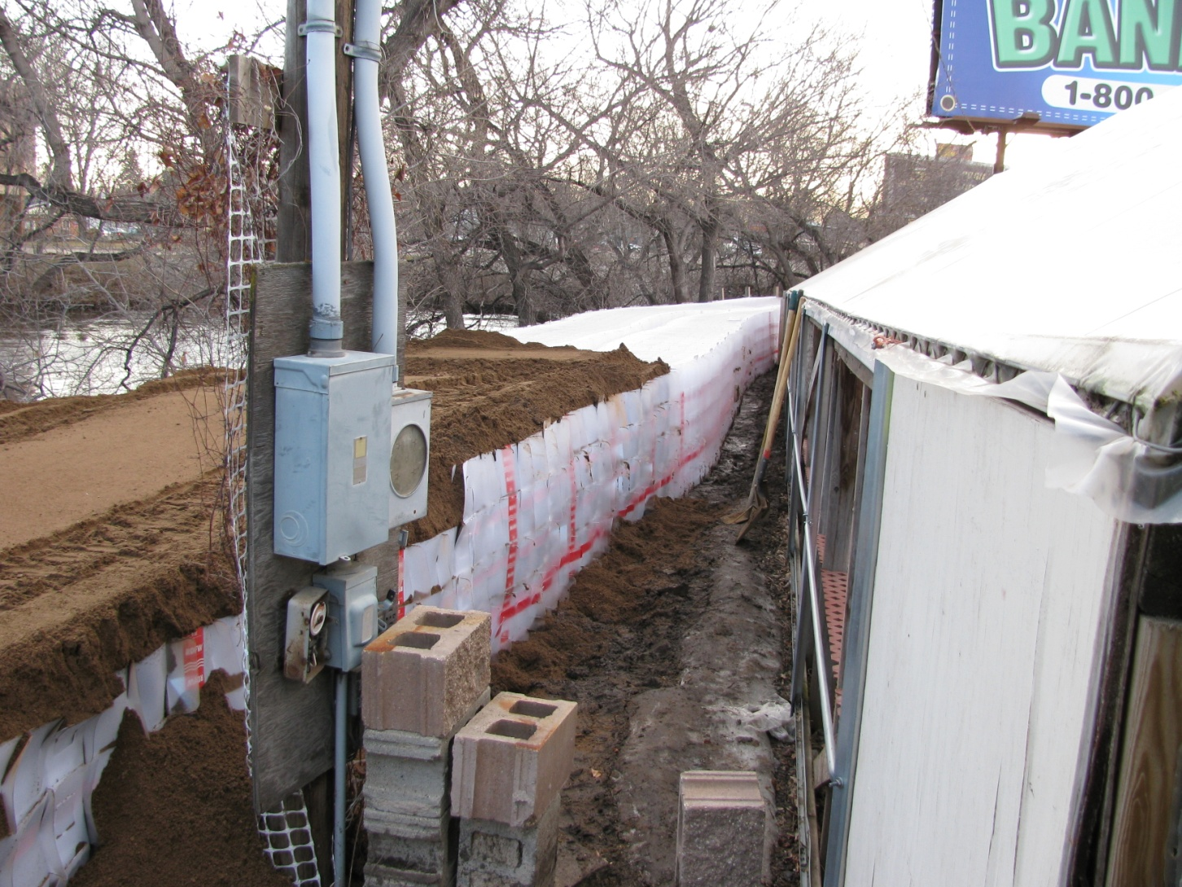
Expedient Protection in Confined Areas

Slide 25
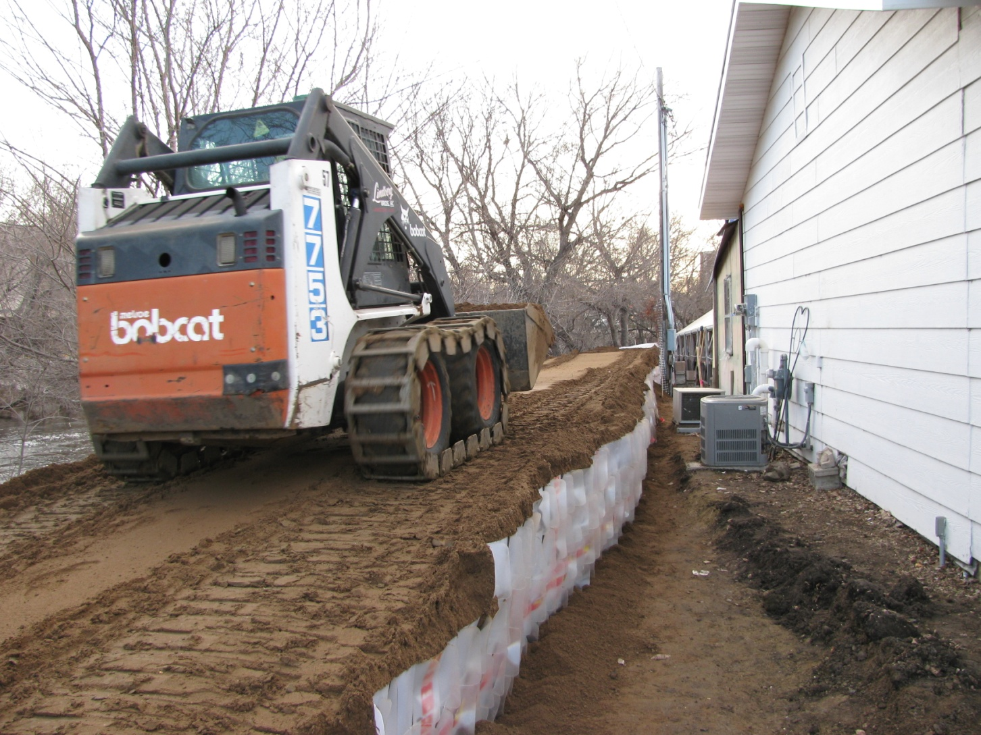
Skid Loader Filling and Travels Over Top of
RDFW Structure

Slide 26
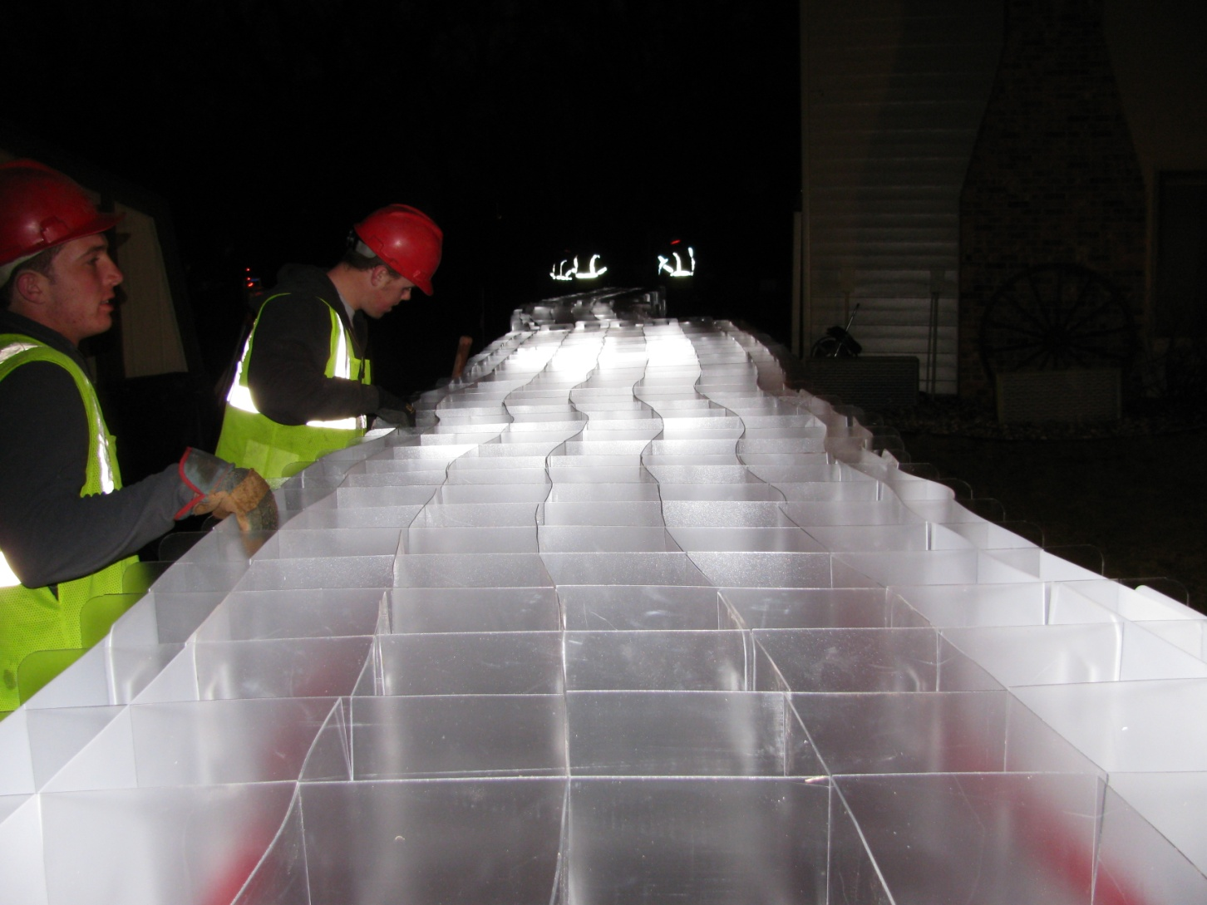
Working With Low Visibility

Slide 27
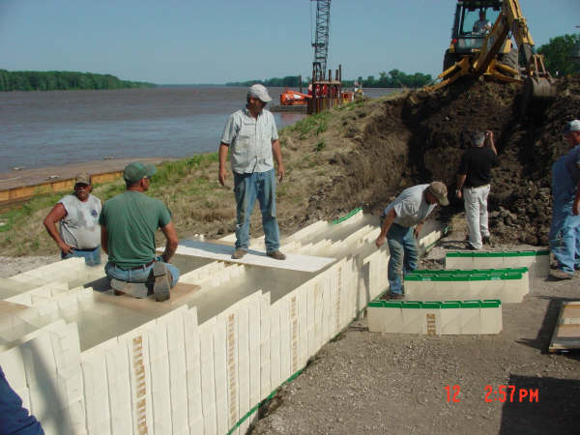
RDFW Is Scalable
Can be Immediately Widened

Slide 28
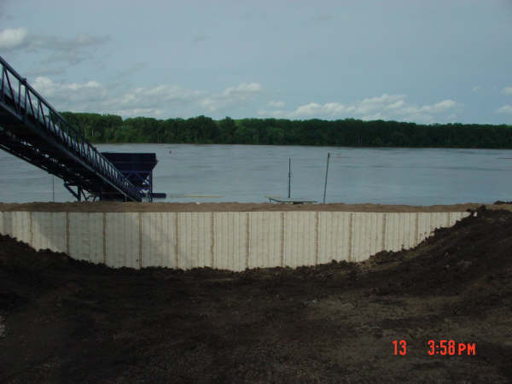
RDFW Levee Closure
Mississippi River Palmyra MO.

Slide 29
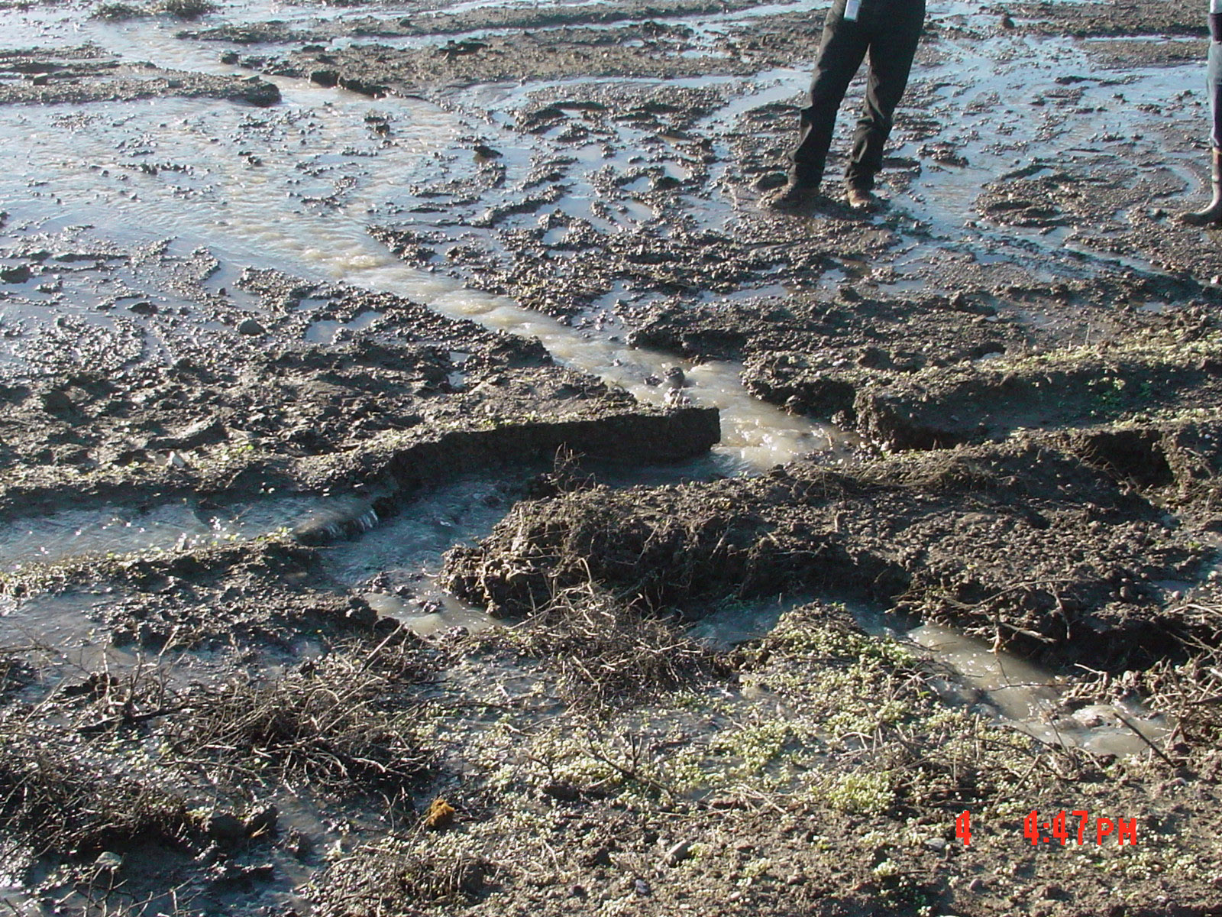
Boil Control

Slide 30
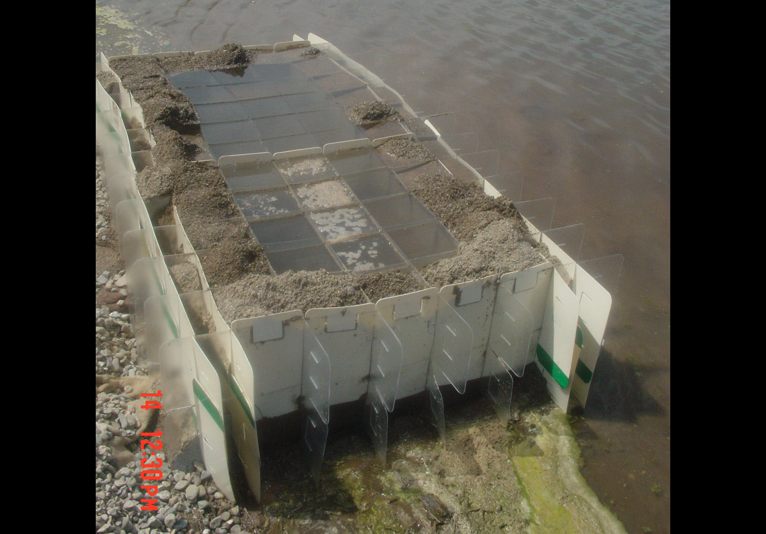
2 Workers in a Pickup Truck
Quickly Install and Monitor RDFW

Slide 31
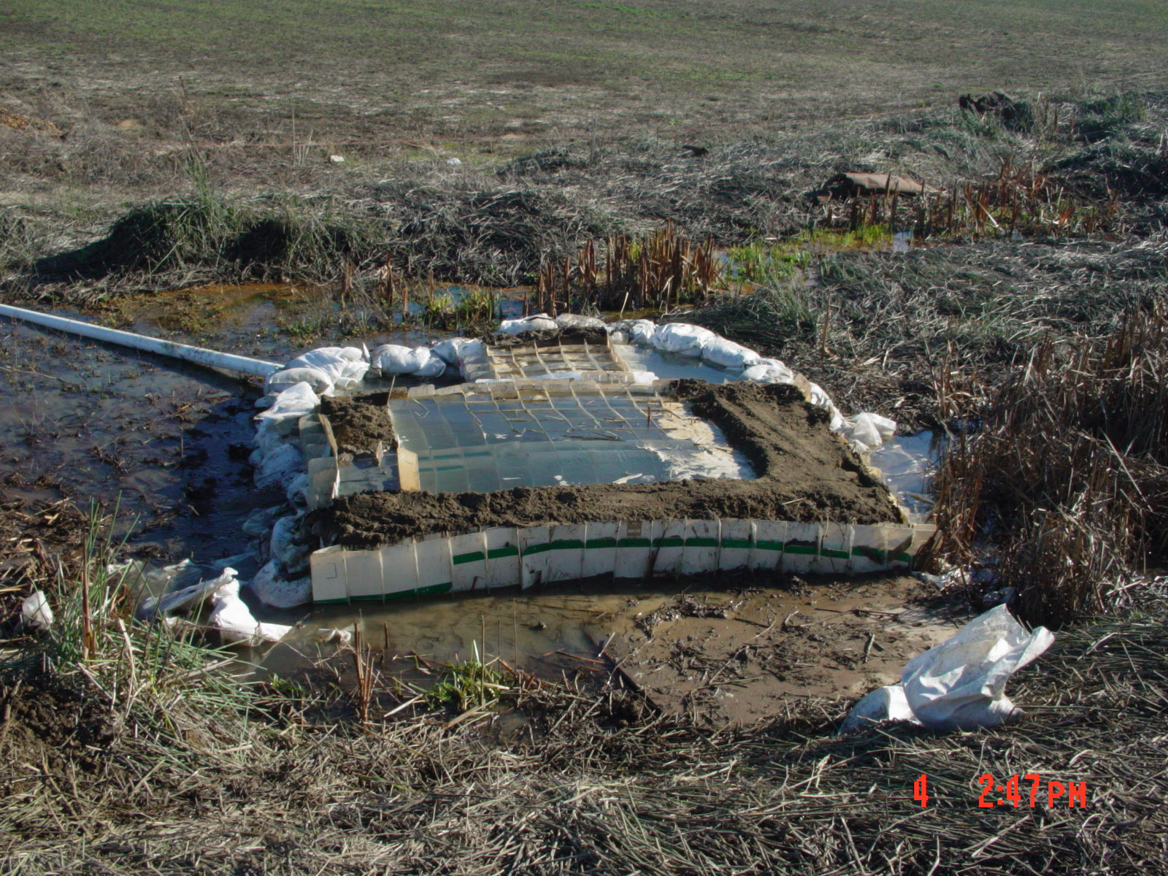
Boil Control

Slide 32
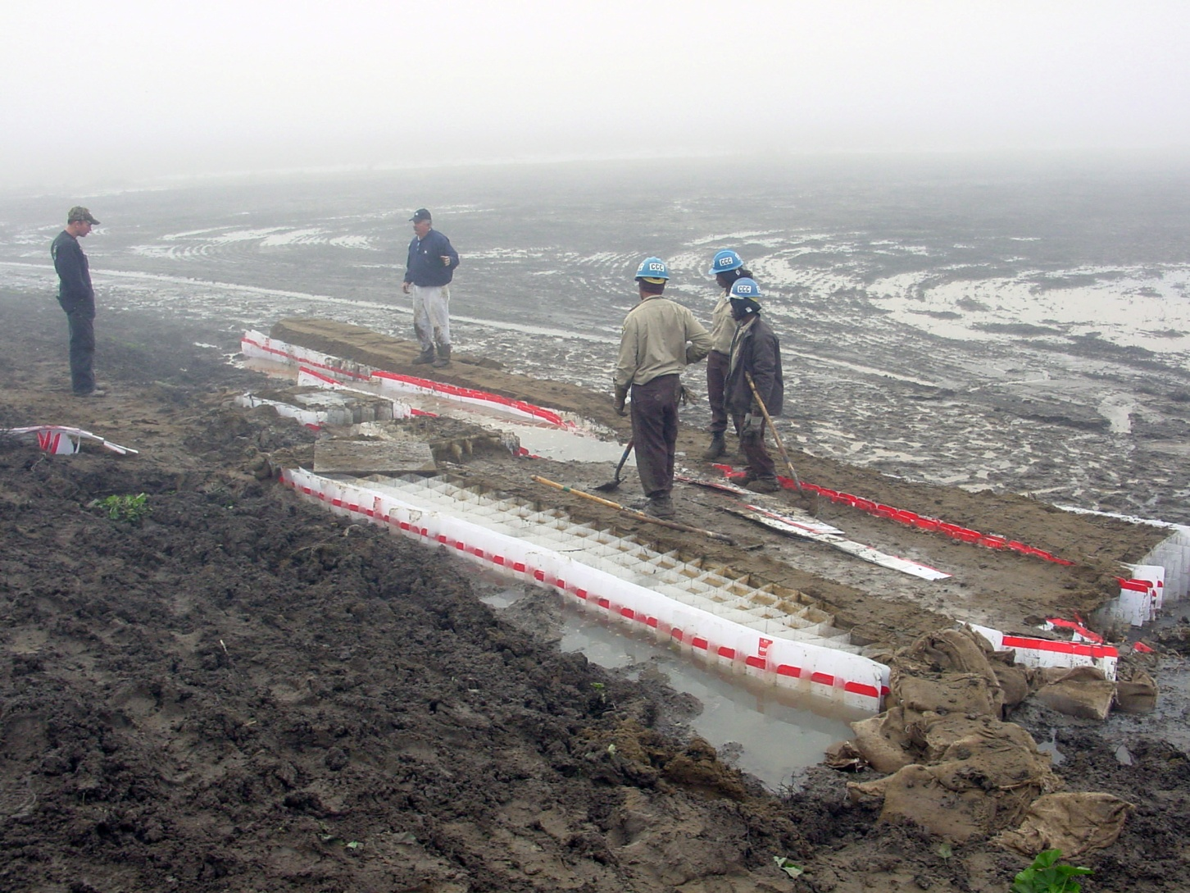
Boil Control Methods

Slide 33
Rapid Deployment Food Wall (RDFW)
Government Agencies
Acknowledgments and Testimonials

Slide 34
What They Are Saying
International Designers Choice Award.- Overall
Industrial Designers Society of America – Gold
Selections Committee Judge - Isabel Acona
USACE Omaha District –
Field Coordinator - Jude Hobza
USMC 1st Combat Engineer Batallion (1st CEB) Chief of Engineering, Master Gunny Sergent
- Manuel Diaz

Slide 35
Industrial Designers Society of America – IDSA
International Design Excellence Award
"This is one of my favorite entries. Such a simple holistic solution to a labor intensive, complex and increasingly persistent problem. Thorough testing has shown that the solution is more effective than traditional flood barriers, and has clearly helped to design a product that is so easy to install, scale to different situations, remove, store, reuse and recycle." --Isabel Ancona

Slide 36
North Dakota Flooding 2009
Jamestown – Lamoure ND
“We used it in multiple locations and built our way in between tight quarters; river banks and buildings where it was difficult to access with Alternate Methods
…Also where we needed variable heights.
We also used it where access from either side was not possible due to saturated
conditions…restricting access of equipment.
…Jude Hobza, USACE Field Coordinator

Slide 37
Field Comments
“RDFW is in a different league. Its adaptability, strength and versatility cannot be compared to other earth filled structures.”
Chief of Engineering, 1st CEB US Marines
Master Gunny Sergeant, Manuel Diaz

Slide 38
US Congress
Energy and Water Conference Committee
2004 Report
“Geocell Systems RDFW can be
Cost-Effective, Quick to Deploy, and
Superior to Traditional Sandbags
Protecting Property from Flood Damages
Flood Damages Total Millions in Dollars Each Year”

Slide 39
What We Bring to the Fight
RDFW Tested, Accepted, and Deployed in Declared Emergency Flood Incidents such as
  Cedar Springs Utah, Jamestown ND, Lamoure ND,
  Minot ND
  Sacramento Delta CA (DWR)
A Proven Next Step in Flood Fighting Technology
    Structural Strength,
    Less Manpower
    Less Fill Material,
    Smaller Footprint,

Slide 40
US National Guard
“RDFW Successful in Minot ND”
National Guard Installations Burlington, ND

Slide 41
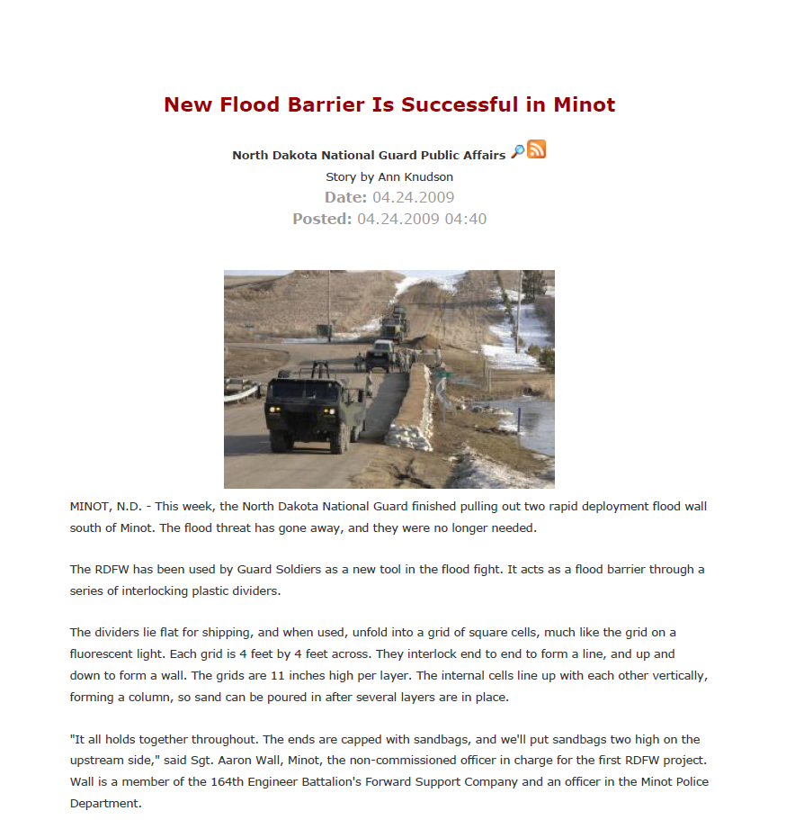
National Guard News

Slide 42
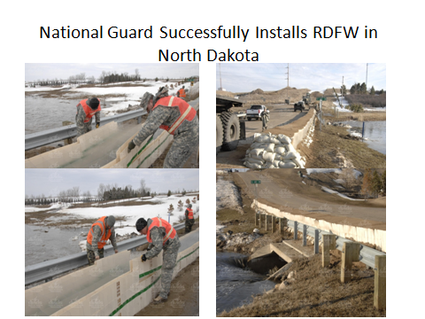

Slide 43

Time Lapse Video

Slide 44
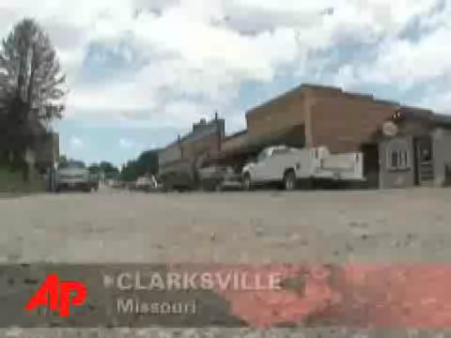
AP Clarksville Video

Slide 45
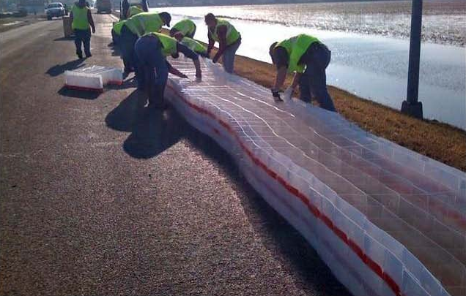
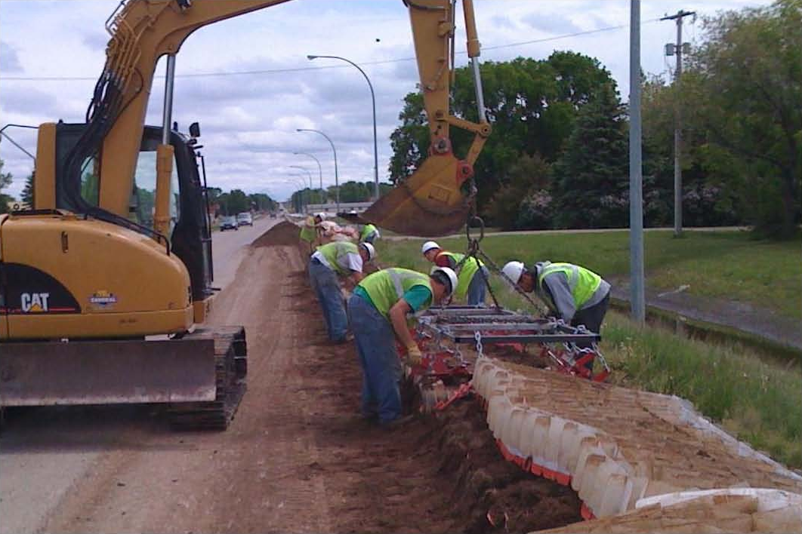
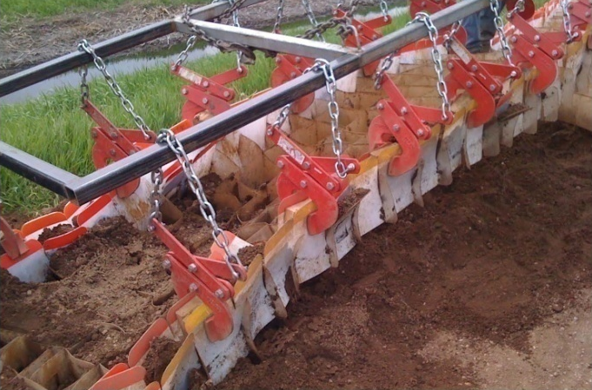
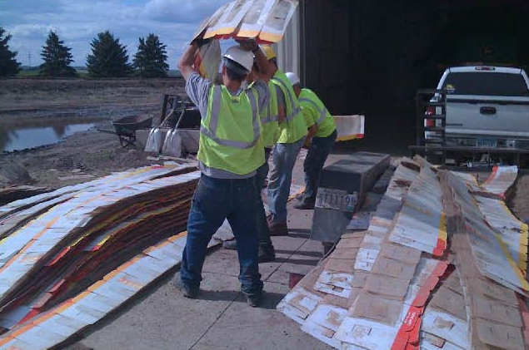
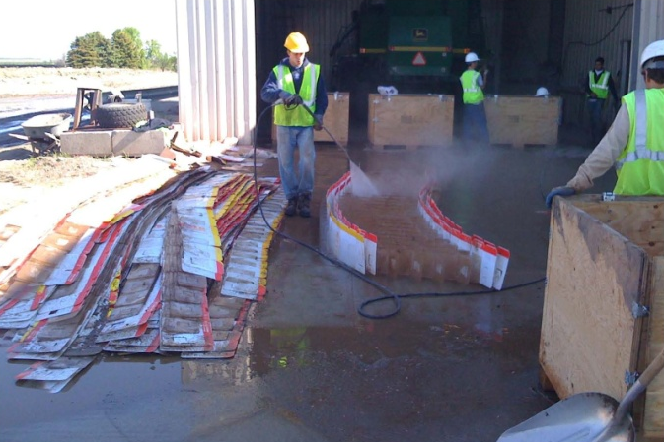
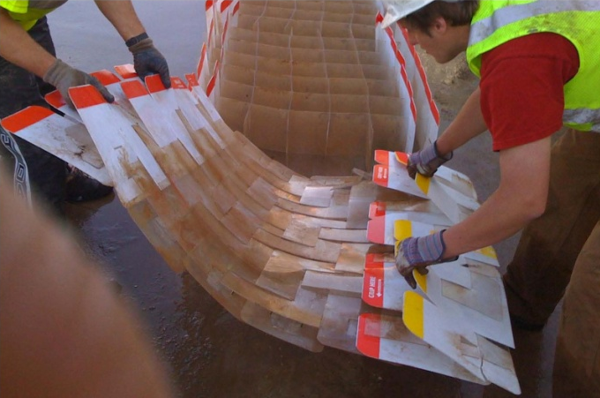
Removal and Re-use

Slide 46
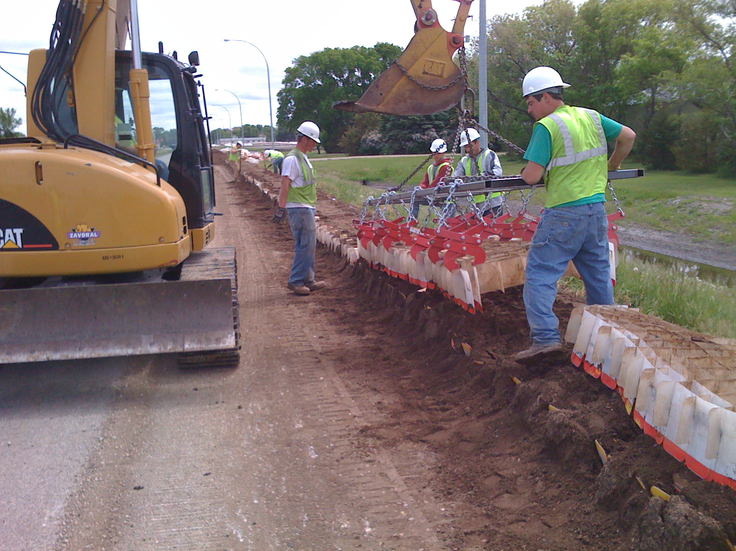
Excavator and Attachment lifts 4 sections per pull. Sand falls from bottom of each pull

Slide 47
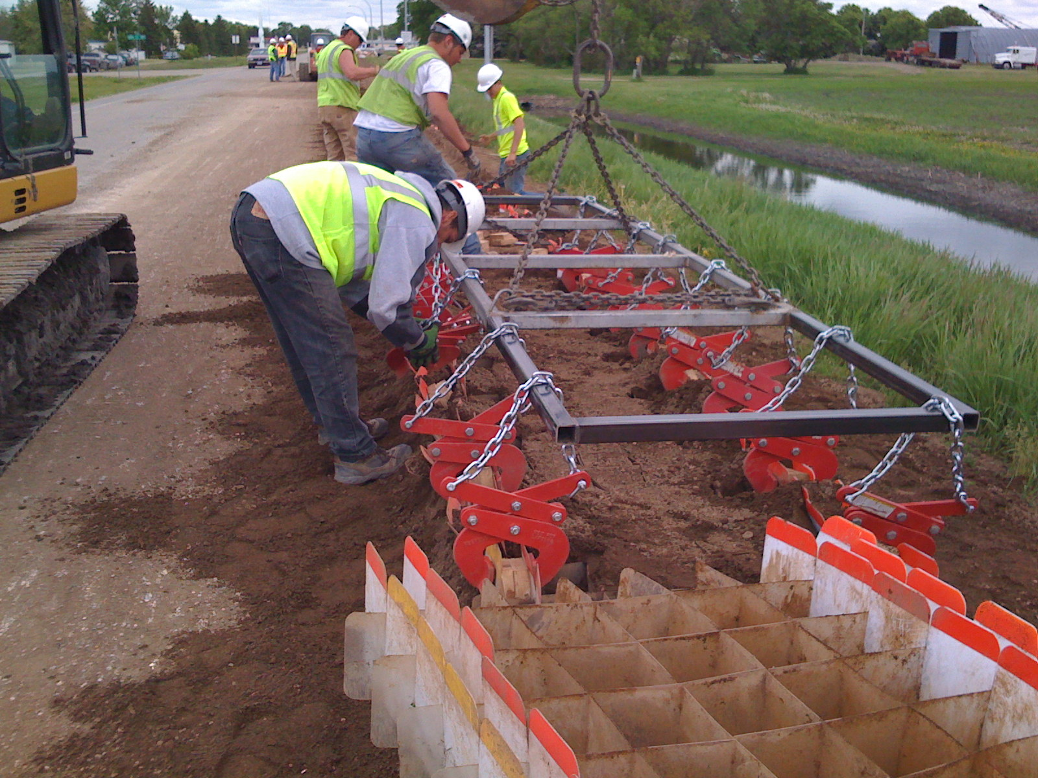
Attachment Set to pull

Slide 48
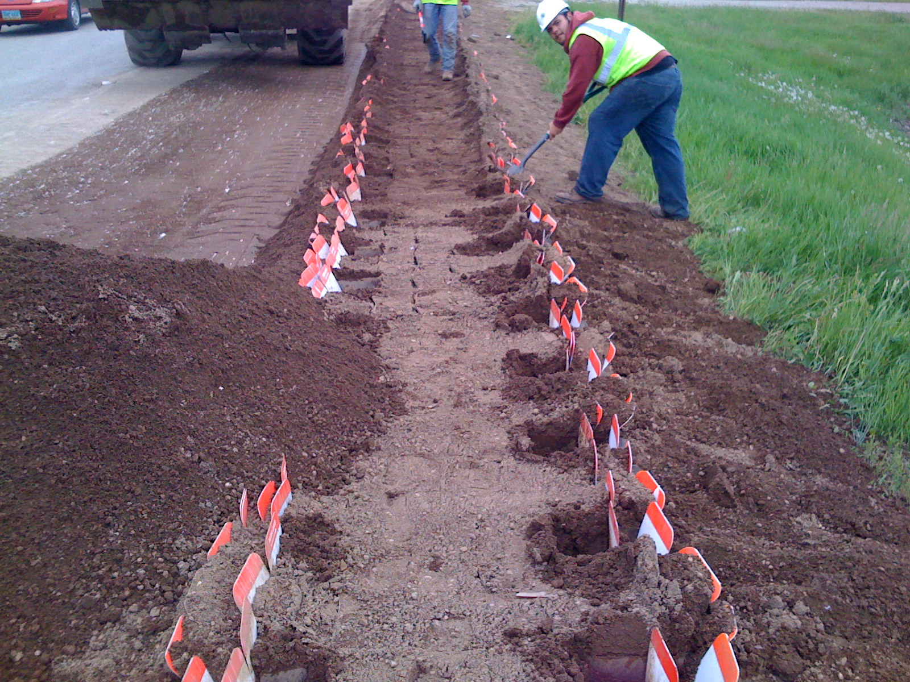
Loader Scrapes and Hauls Off Excess Dirt. Crews Work Ahead to Clean out Outside Cells for Grapplers

Slide 49
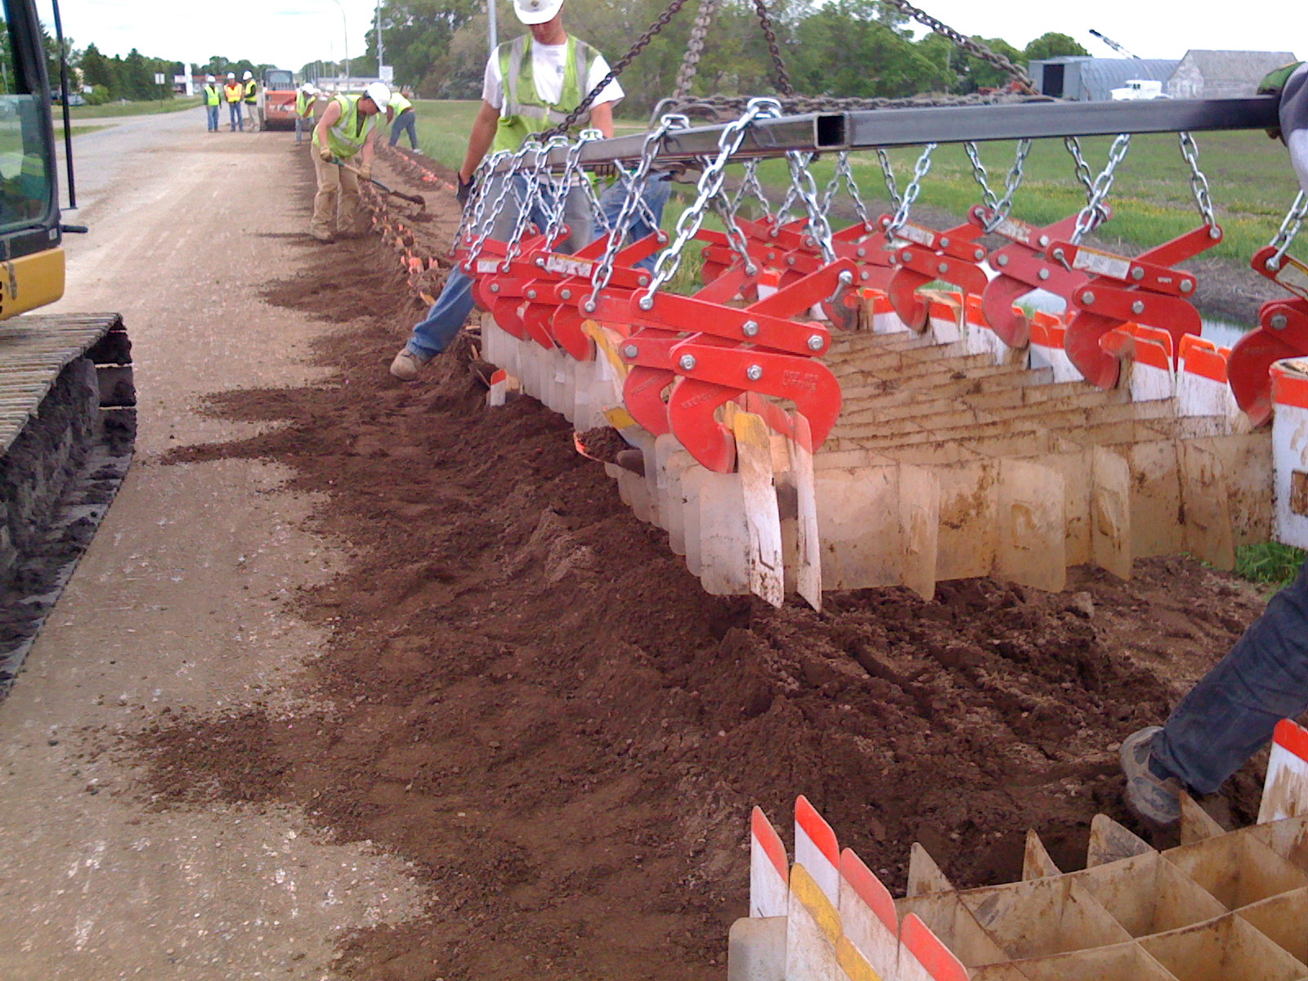
Each Pull Averages 2.5 minutes

Slide 50
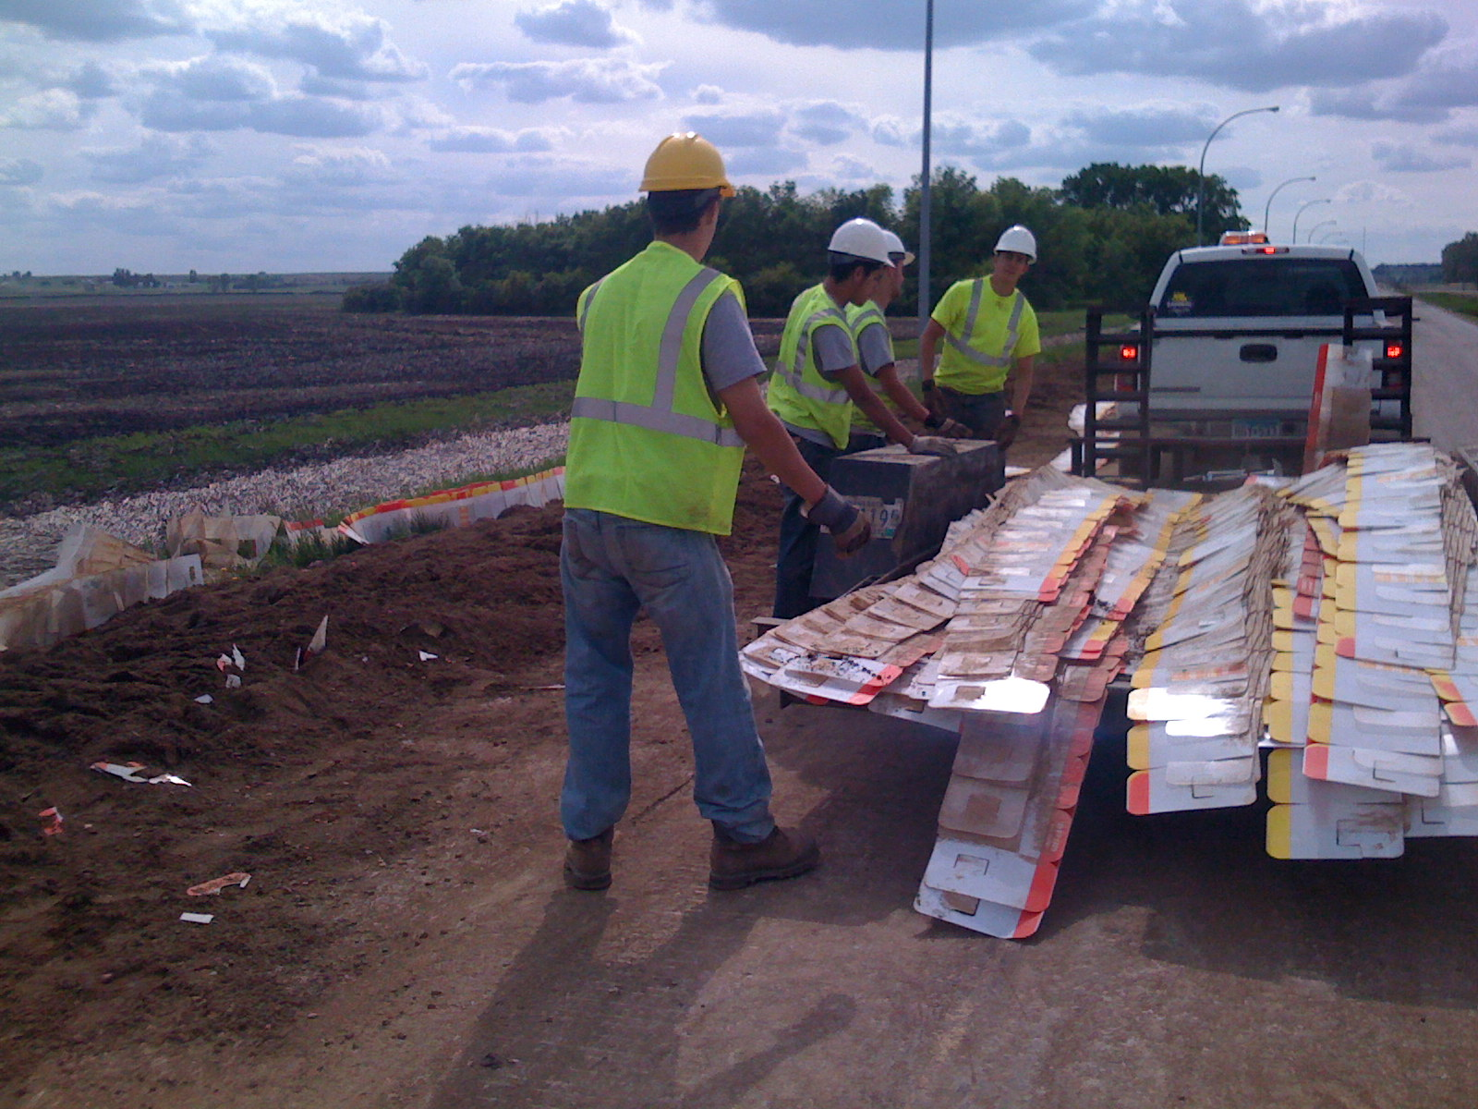
Cleaning Crews Collapse 4 Sections. Place on Trailer. Haul to Staging Area

Slide 51
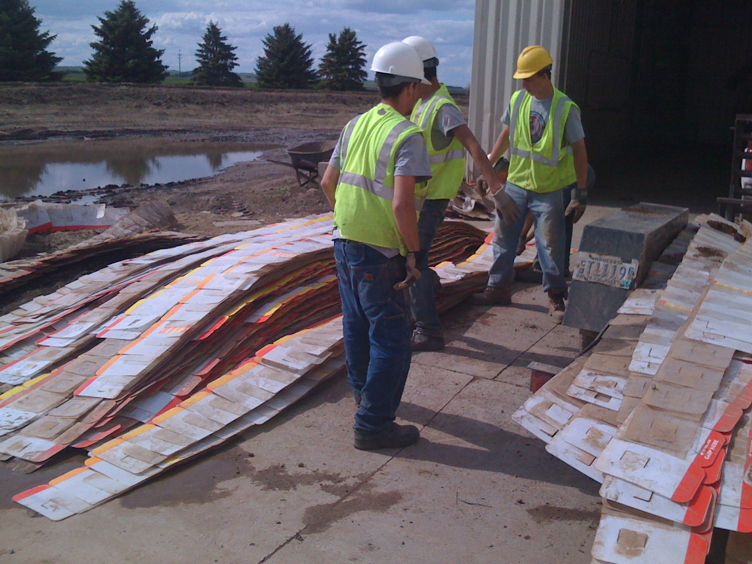
Crews Stage RDFW for Cleaning

Slide 52
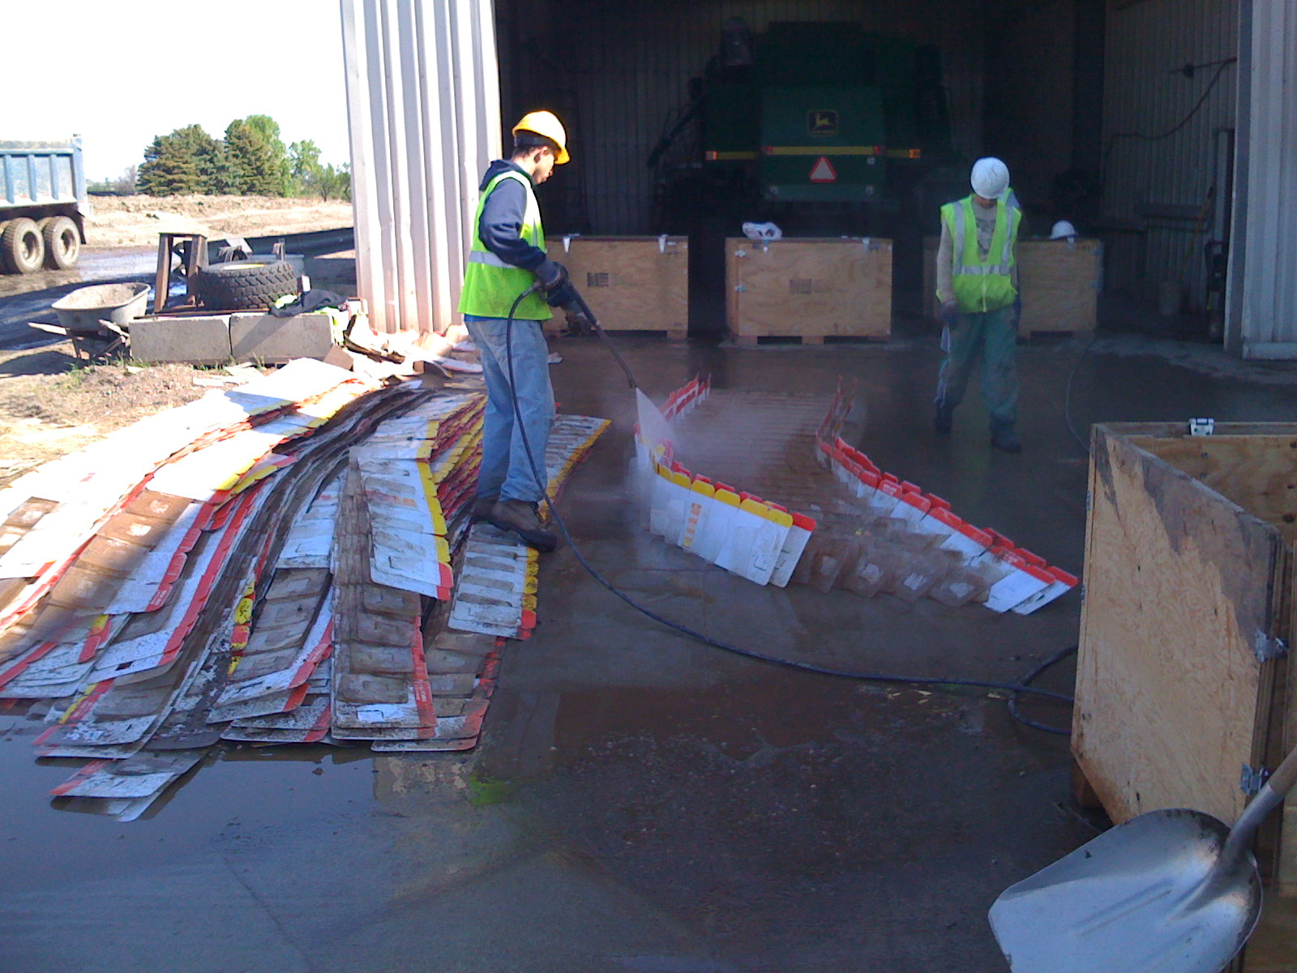
Spray Washing RDFW Prior to Re-packaging

Slide 53
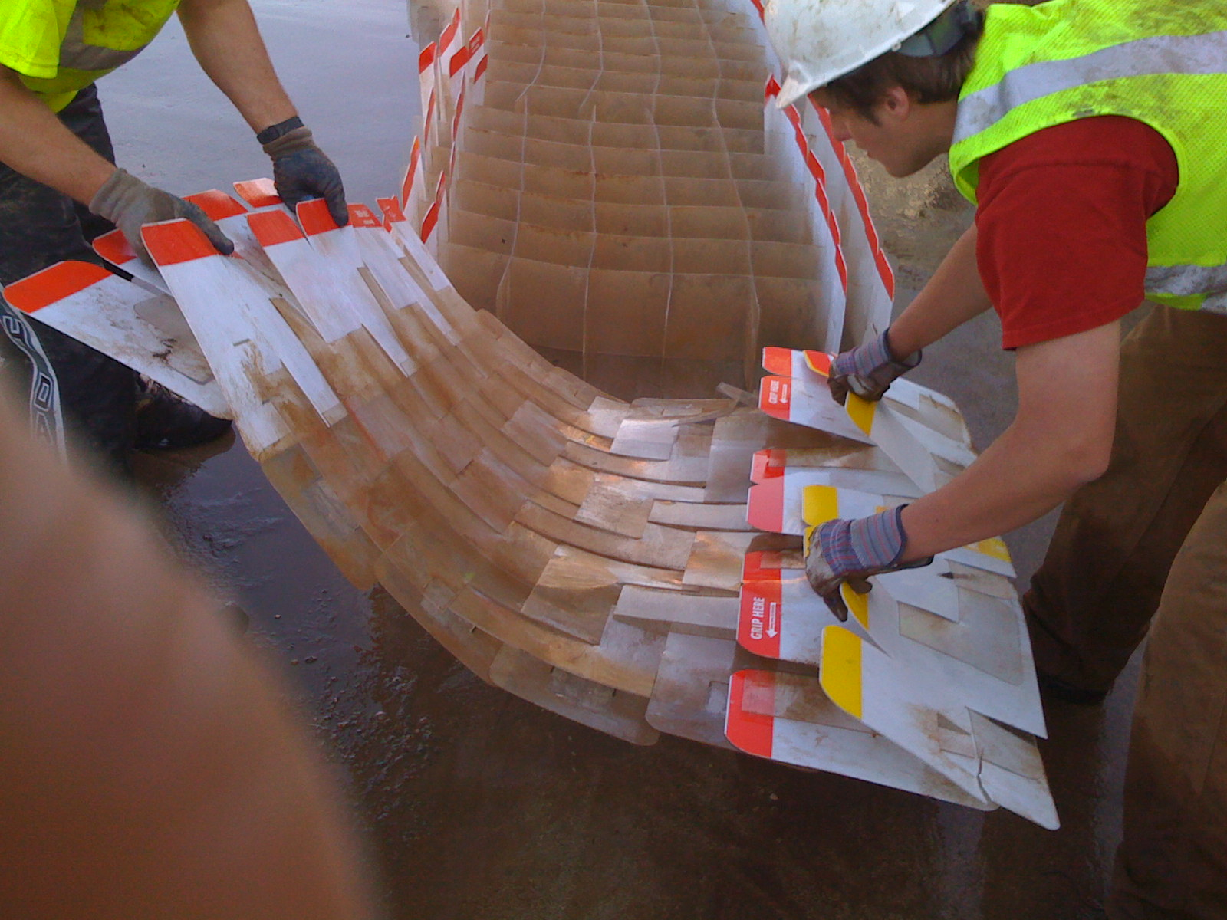
Disconnecting and Collapsing RDFW prior to Placing in RDFW Containers for re-use

Slide 54
RDFW is a Multifaceted Flood Fight Tool
Flood Barrier
Various heights
Various widths
Levee Overtopping – Splash Berm
Access Road Stabilization
Mudslide Diversion
Beach Erosion Control
Soil Stabilization
Boil Control
Embankment Stabilization

Slide 55
RDFW Summary
RDFW a proven solution
  increase protection
  reduce recovery costs.
  RDFW is easy to use, cost effective and reliable
Geocell Systems RDFW is “Made in the USA”
RDFW is re-useable
RDFW is recyclable

Slide 56
Going Forward
Adequate Supply of RDFW Nation Wide
Pre-deploy Inventories in Regional Areas
Geocell has an on going USACE National Advisory Contract for RDFW deployments
  On site training
  Installations
  Monitoring
  Removal

